Slide 1
Machine Learning Algorithms in Depth
Done By: Qusai Al-Buqaeen/ ShAI
Date: 29/10/2022

Slide 2
What are we going to learn today?
Understanding what's under the Hood of ML algorithms.
Linear Regression, How does it learn?
Gradient Descent and its types.
Logistic Regression, the Sigmoid function, and how does it learn?

Slide 3
What have we learned so far concerning ML?
We learned about the basic concepts of ML, regression, classification, supervised ml, unsupervised ml, etc.…
But so far we have been treating the ML algorithms like a black box, but today we will actually discover what’s under the hood.
How do these algorithms learn? And how can we optimize the model to best fit our objective?
Note: This lecture includes a lot of concepts of linear algebra and calculus, but don’t worry we will be concerned about the general idea.

Slide 4

Linear regression
Linear regression equation :
Where :
ŷ is the predicted value.
n is the number of features.
x is the i feature value.
θ is the j model parameter, including the bias term θ and the feature weights θ , θ , ⋯, θ .

Slide 5

Linear regression (vectorized form)
This is the vectorized form of the Linear regression
Where :
h is the hypothesis function, using the model parameters θ.
θ is the model’s parameter vector, containing the bias term θ and the feature weights θ to θ .
x is the instance’s feature vector, containing x to x , with x always equal to 1.
θ · x is the dot product of the vectors θ and x, which is equal to θ x + θ x + θ x + ... + θ x .
Note: In Machine Learning, vectors are often represented as column vectors, which are 2D arrays with a single column. If θ and x are column
vectors, then the prediction is ˆy = 𝛉⊺x, where 𝛉⊺ is the transpose of θ (a row vector instead of a column vector) and 𝛉⊺.x is the matrix
multiplication of 𝛉⊺ and x.

Slide 6
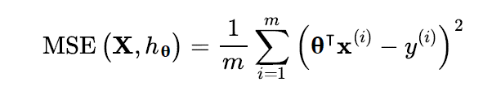
How do we train the linear regression?
training the model means that we need to set the parameters so that the models best fits the training set.
Therefore we need a performance measure, and we will optimize the Mean squared error (MSE), to try and minimize its value.

Slide 7
Methods to train and optimize linear regression
Closed form ( normal equation)
Gradient descent:
Batch gradient descent
Mini-Batch gradient descent
Stochastic Gradient descent

Slide 8
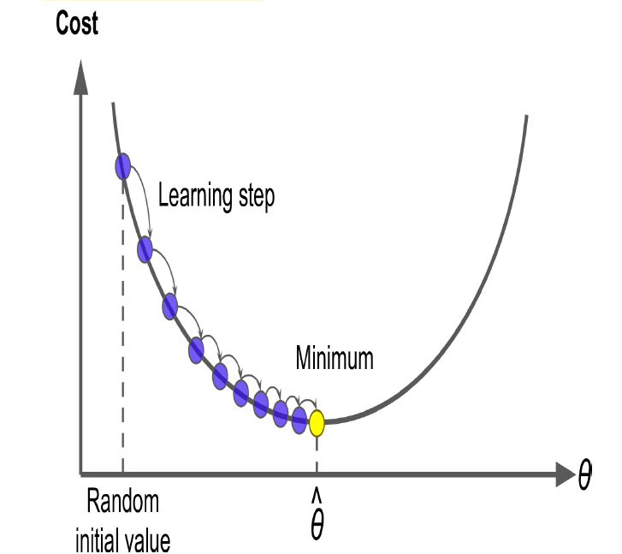
What is Gradient descent
Gradient descent is an optimization algorithm used to find optimal solutions for a wide range of problems. It iteratively tweaks the parameters to minimize a cost function.
GD measures the local gradient of the cost function with respect to the parameter vector 𝛉, and it goes in the direction of the descending gradient, once the gradient is zero you have reached the optimal solution for 𝛉.
In practice we start by assigning a random value for 𝛉 then the GD will optimize the value.
One important thing about the GD is the learning rate or the STEP SIZE. IF THE LEARNING RATE IS TOO SMALL THEN IT WILL TAKE THE ALGORITHM A LONG TIME TO CONVERGE. ON THE OTHER HAND IF IT IS TOO BIG WE MIGHT MISS THE OPTIMAL SOLUTION.

Slide 9
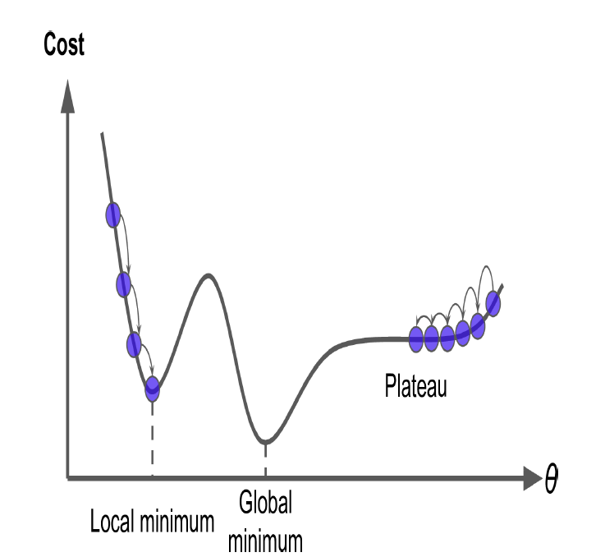
Things to consider when using gradient descent
When using gradient descent you should ensure all features have the same scale, this can be done using Scikit learn’s standard scaler.
When the number of parameters of the model increase the time for the gradient descent to find the optimal parameter will increase
Luckily, for the linear regression, the cost function has a convex shape, and the optimal solution is at the bottom.
Some other cost functions might have a local and a global minimum which makes it harder for the gradient descent to find the optimal solution.

Slide 10
Types of Gradient Descent
Batch gradient Descent (full gradient descent)
Mini-Batch Gradient Descent
Stochastic Gradient Descent
We will explain each type and its advantages and disadvantages.

Slide 11

Batch Gradient Descent
The batch gradient descent uses the whole training dataset X at every step.
so basically GD works by computing the gradient of the cost function with respect to each parameter θ (partial derivative). In other words how much the cost function will change if θ changes.
Resulting in the following equation, where the learning rate (step size) comes into play

Slide 12
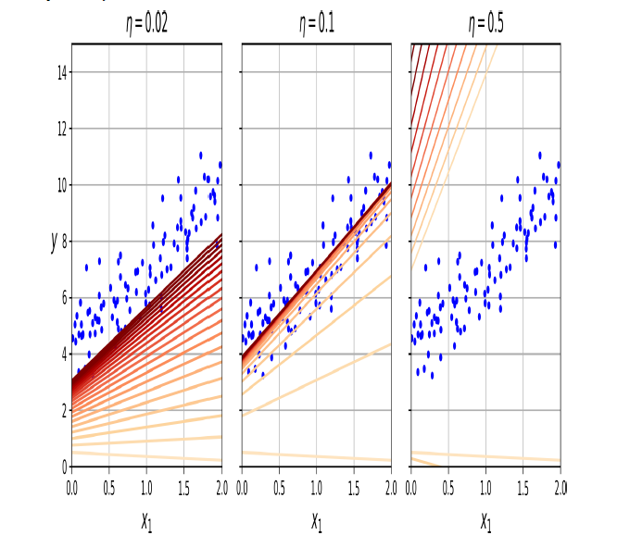
Why is the learning rate important?
On the left the learning rate is too small, GD will reach the optimal solution but it will take a long time.
The middle graph shows the best learning rate
The right graph, the learning rate is too big, the algorithm diverges and misses the optimal solution.
To find the optimal learning rate we can use grid search with high number of epochs, and when the change in gradient becomes too small we interrupt the search.

Slide 13
Stochastic gradient descent
Stochastic gradient descent picks a random single instance in the training dataset at each step, and computes the gradient with respect to that instance only.
sGD is faster than batch gD, but Batch gradient descent is more likely to find the optimal solution.
When SGD is very close to the minimum it will continue bouncing around, and never settling down due to its stochastic nature.
sGD is better to use when the cost function is very irregular like the one on the right.
Also it is good to start with a high learning rate to escape the local minimum, and then use a lower learning rate to settle at the global minimum.
It is also important to shuffle the data before using SGD to make sure that the data is independent and identically distributed
To perform linear regression with Sgd we use SGDregressor from sklearn.

Slide 14
Mini batch gradient descent
Mini batch gradient descent computes the gradient using mini batches from the training dataset.
Mini batch gradient descent is less erratic compared to SGD, which makes it hard for mini batch to escape the local minima

Slide 15
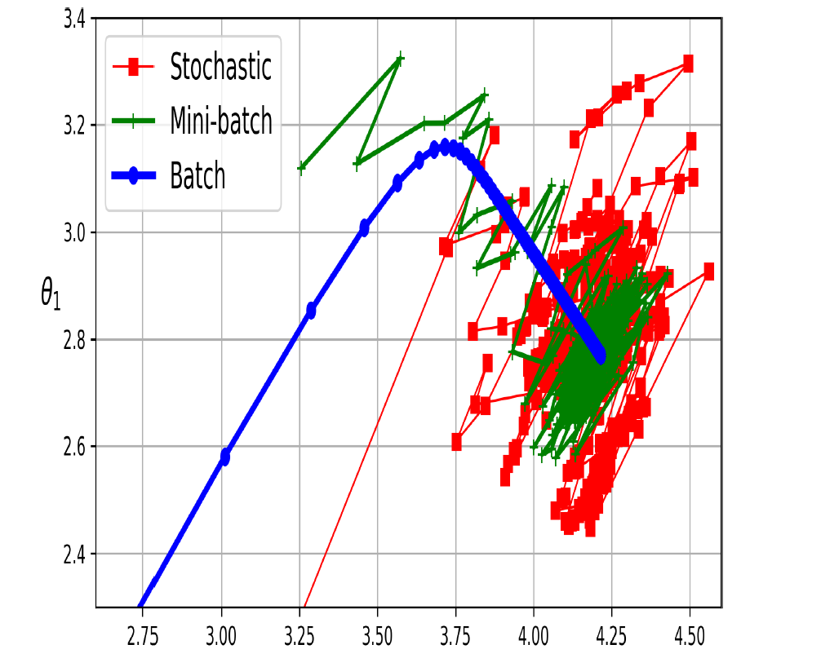
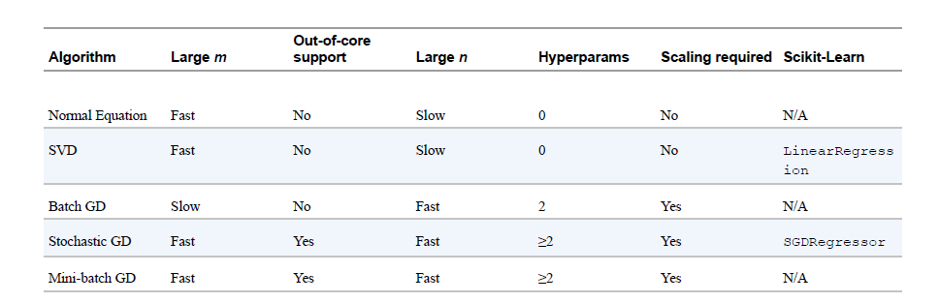
Difference between the three types of GD
We can see that the batch gradient descent is slower with larger datasets that have more features compered to the SGC and the min batch GD.
Also batch gradient descent reaches the optimal solution while min batch and SGD keep bouncing around the optimal solution.

Slide 16
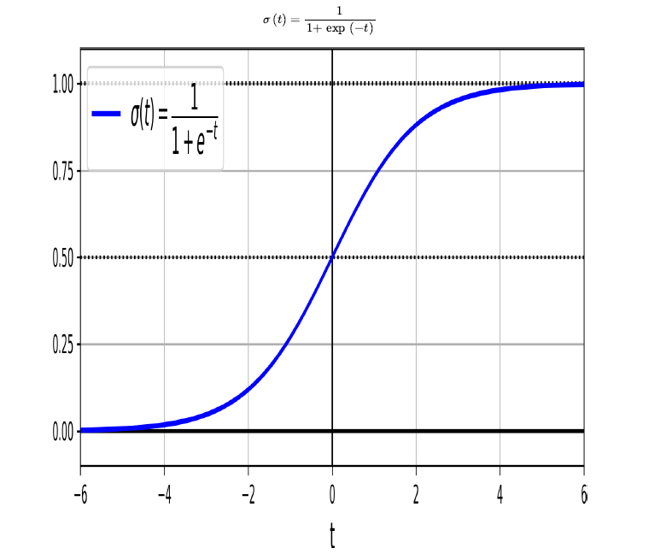

Logistic regression
It is used to estimate the probability if an instance belongs to a certain class. If the probability is greater than a certain threshold (usually 0.5) then the instance is assigned to the positive class (1), if the probability is less than 0.5 it is assigned to the negative class (0).
Just like linear regression, the logistic regression computes the weighted sum of the input features plus the bias term, and it outputs the logistic of these terms using a sigmoid function.

Slide 17


Logistic regression
Once the logistic regression model is trained and has outputted the probability of the instance, then it can make its prediction ŷ easily.
We can use gD to optimize the cost function of the logistic regression model, which is the log loss. The logistic regression also has a convex cost function, so its optimization is easy with batch gradient descent.

Slide 18
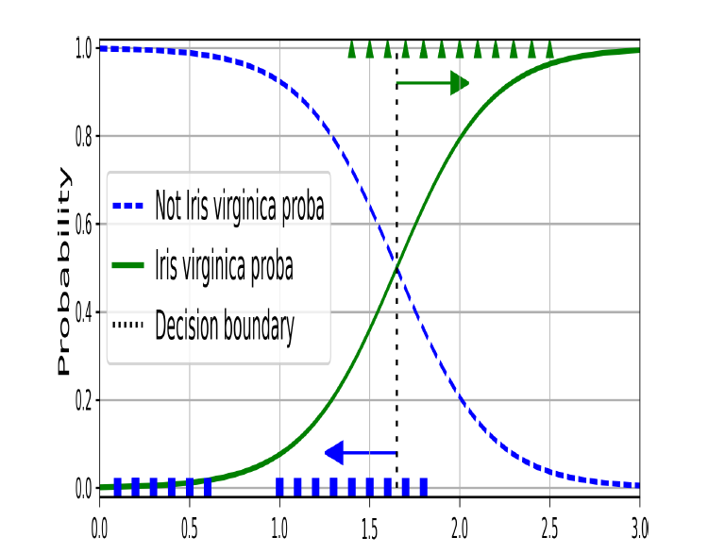
Decision boundaries
Logistic regression can be optimized using Gradient descent to find the optimal decision boundary which separates the two classes.

Slide 19
Resources
https://github.com/ageron/handson-ml3/blob/main/math_linear_algebra.ipynb
Chapter 4 from the book
https://www.youtube.com/watch?v=sDv4f4s2SB8
https://towardsdatascience.com/gradient-descent-algorithm-and-its-variants-10f652806a3

